Slide 1


Team 37: Microhistological Analysis of the Dietary Habits of Sheep: GrazeView AI
Bi-Weekly Update 2
Godson Edewor, Arnav Gokhale, Jack Nelson, and Nate Scott Sponsor: John Lusher TA: Sabyasachi Gupta

Slide 2
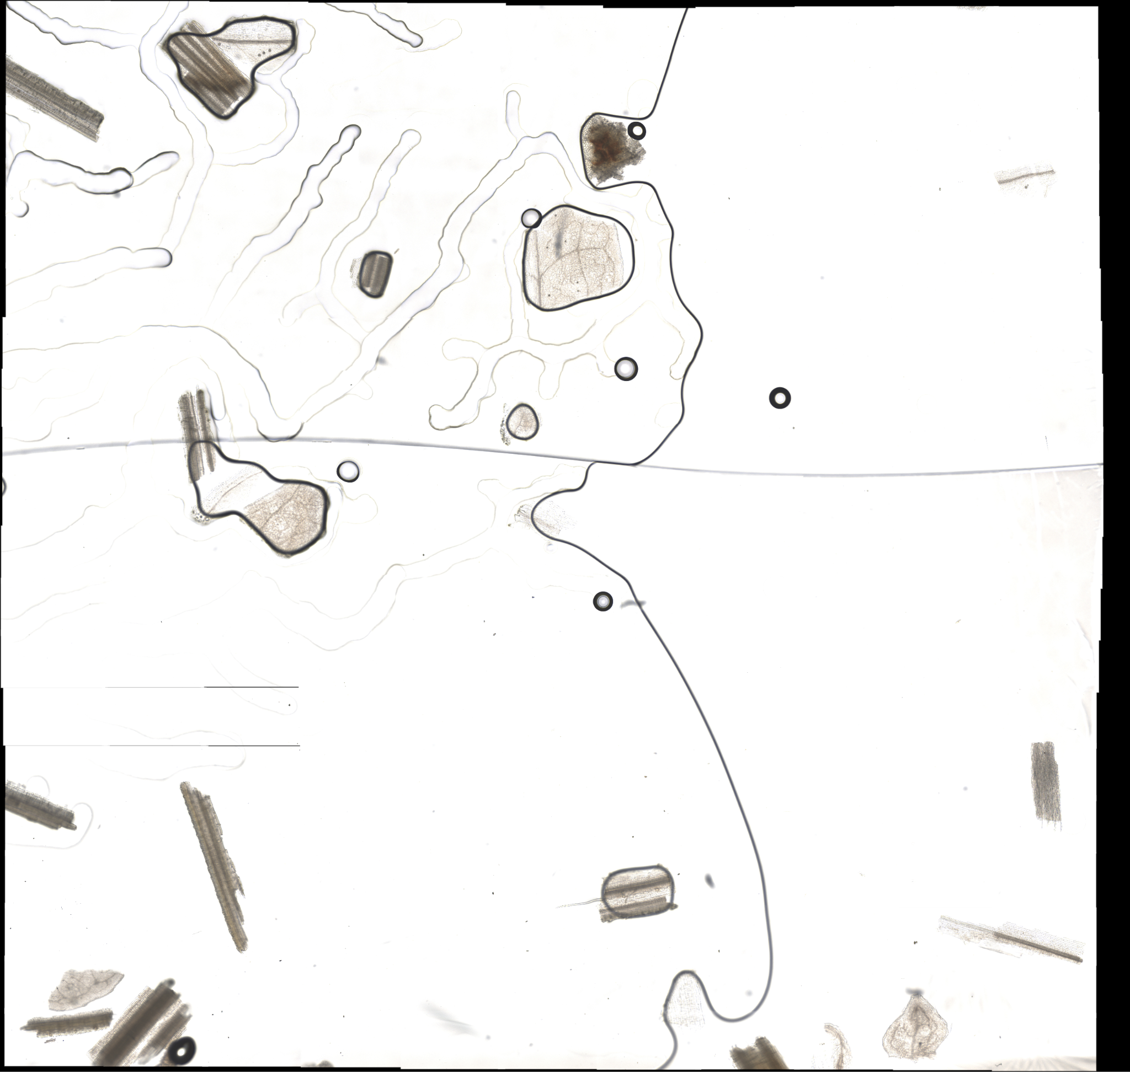
Project Summary
Problem Statement:
TAMU AgriLife is currently investigating the Dietary Habits of Sheep and the effect it has on their wool.
This can be a very time consuming effort, when analyzing microscopic samples by hand.
Solution Proposal:
GrazeView AI will allow the process of analyzing these microscope slides to become automated.
This will save TAMU AgriLife both time and money spent in training individuals that analyze by hand.

Slide 3
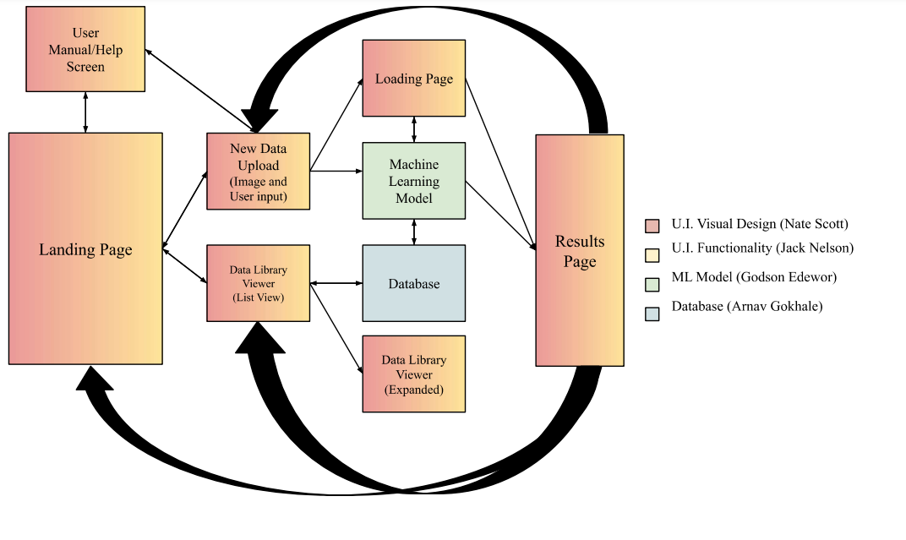
Project/Subsystem Overview

Slide 4
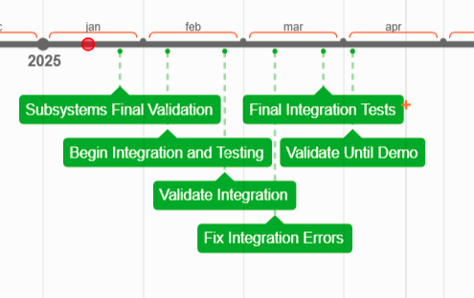
Project Timeline

Slide 5
User Interface
Jack Nelson & Nate Scott
Accomplishments since last presentation [~30 Hours] | Ongoing progress/problems and plans until the next presentation
Applied background designs to all pages Reduced lag across the application Adjusted features to increase ease of use Adjusted resizing events to create a smoother user experience Integration points are prepared within the application’s code Reformatted application to adjust for any screen resolution/DPI | Optimize minor performance issues Integrate the Data Upload, Loading Page, and Results page with ML Integrate the Data Library with the DB

Slide 6
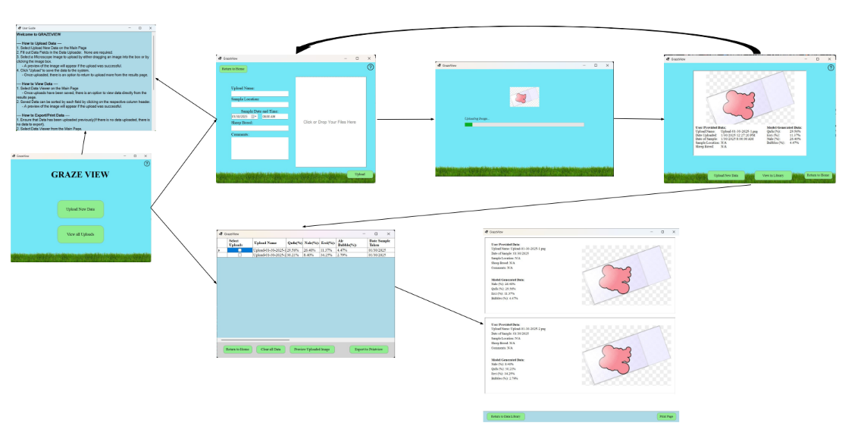
User Interface
Jack Nelson & Nate Scott

Slide 7
Database
Arnav Gokhale
Accomplishments since last presentation [~30 Hours] | Ongoing progress/problems and plans until the next presentation
Created SQL server, managing with Azure Data Studio All CSV based DFs uploaded to SQL DB(Grass & Image) All .PNGs compressed and uploaded to SQL DB All DBs in SQL server are fully automated for new data Connection points identified with notes on connection specifications Increased accuracy for smaller objects in image | Run a VM to access Winforms or workaround Integrate with UI using Microsoft SSMS Receive classifications from ML, add to DB School associated SQL account

Slide 8
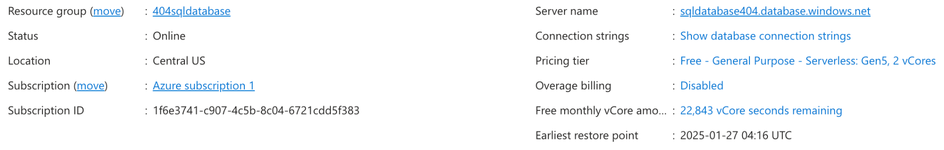
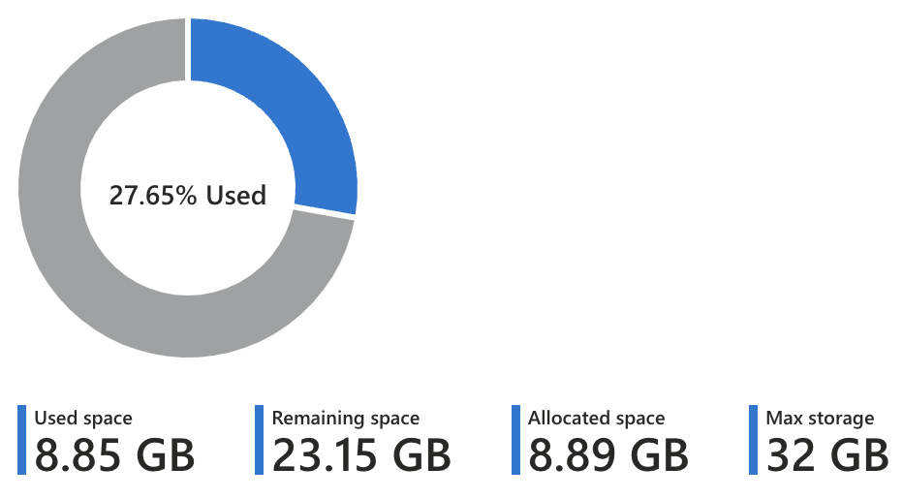
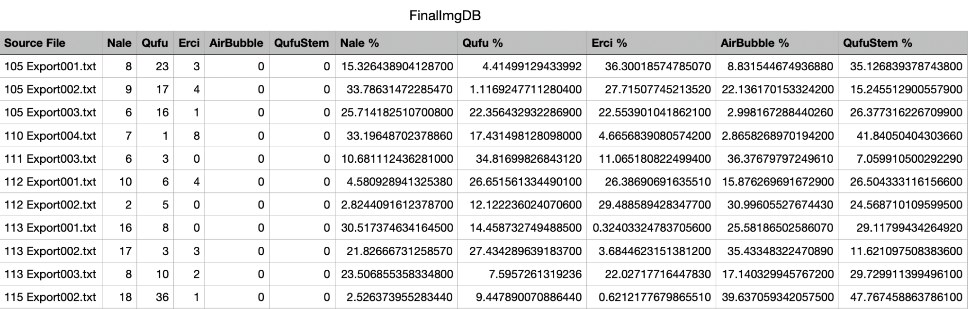
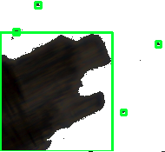
Database
Arnav Gokhale

Slide 9
Machine Learning Model
Godson Edewor
Accomplishments since last presentation [~30 Hours] | Ongoing progress/problems and plans until the next presentation
Machine Learning page created on the c# github repo Tested model transfer learning using YOLOV8 and InceptionV3 Nugets/Libraries/VScode settings configurated for the python to c# translation Model ONNX architecture verified through NetRon | Debugging ONNX conversion for lag/latency errors Continue refining model architecture Display classification outputs to the Web App’s UI

Slide 10
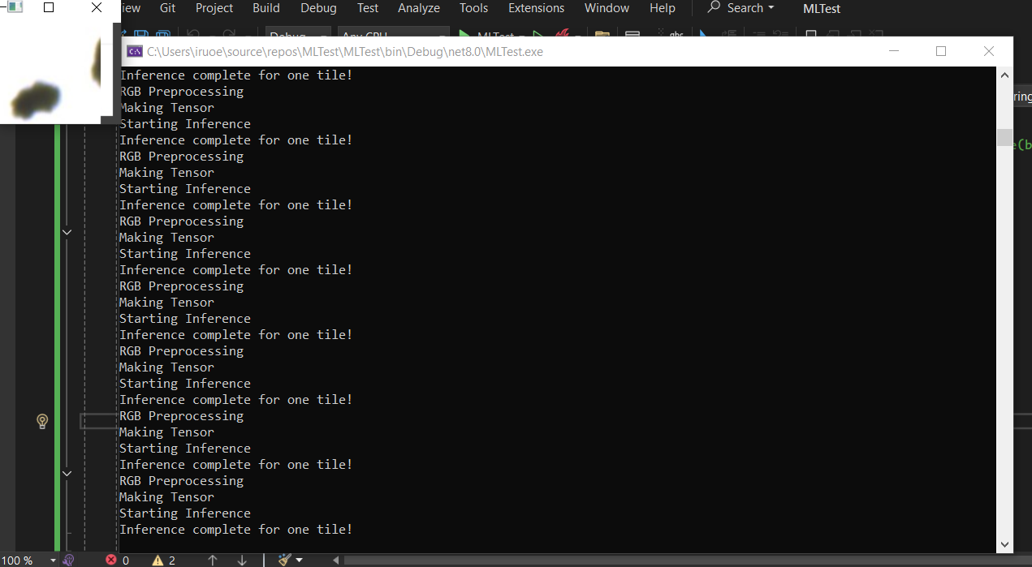
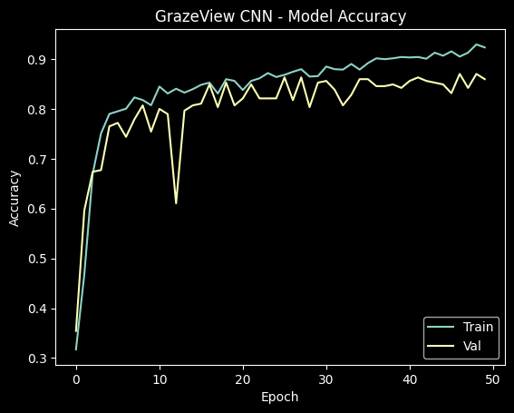
Machine Learning Model
Godson Edewor

Slide 11
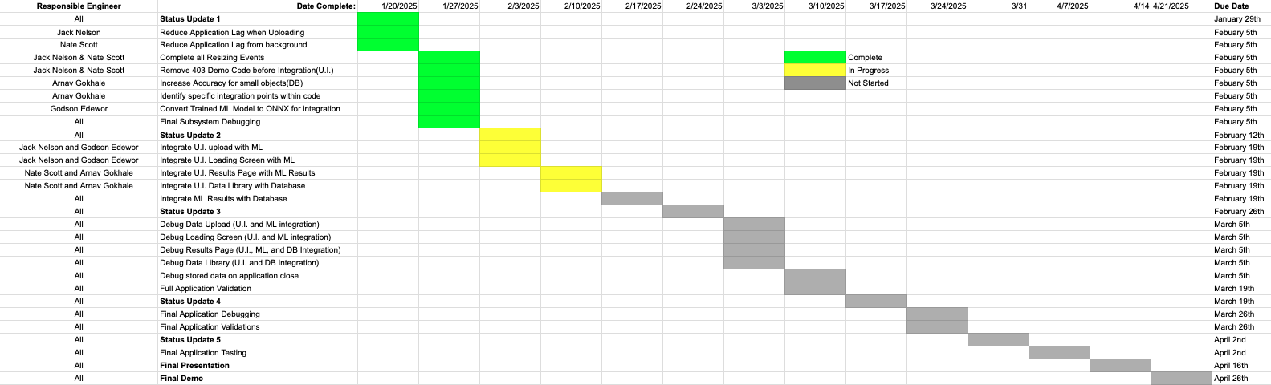
Execution Plan
Notes:
Michelle

Slide 12
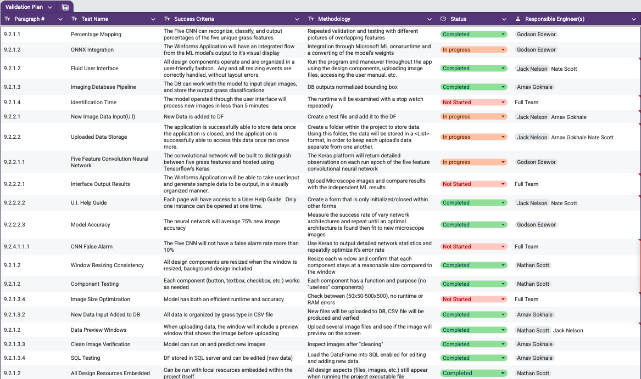
Validation Plan

Slide 13
Thank you!
Questions?

